Slide 1


Reduced Conflict U-turn (RCUT) Intersection Guidance
Mike Vaughn – KYTC Traffic Safety Branch
Travis Thompson – Kentucky Transportation Center
Duane Thomas – Kentucky Transportation Center
September 10, 2026

Slide 2

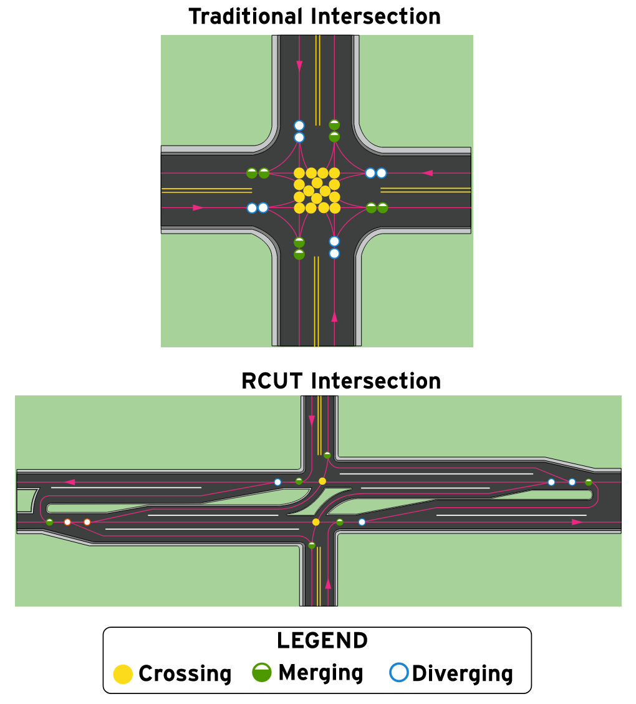
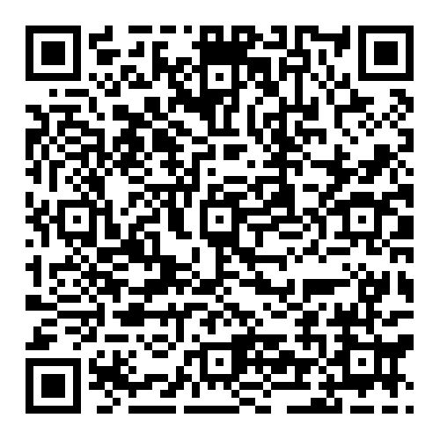
The Safety Case
Source: KYTC RCUT Design Guidance, Figure 5
An FHWA Proven Safety Countermeasure
RCUTs reduce conflict points from 32 to 14.
Crossing conflicts, most critically, drop from 16 to 8.
Remaining conflicts are separated in time and space.
FHWA Proven Safety Countermeasures Website
Notes:
Point out the difference in location of the conflict points between the top and bottom illustrations. It does a good job of showing this.

Slide 3

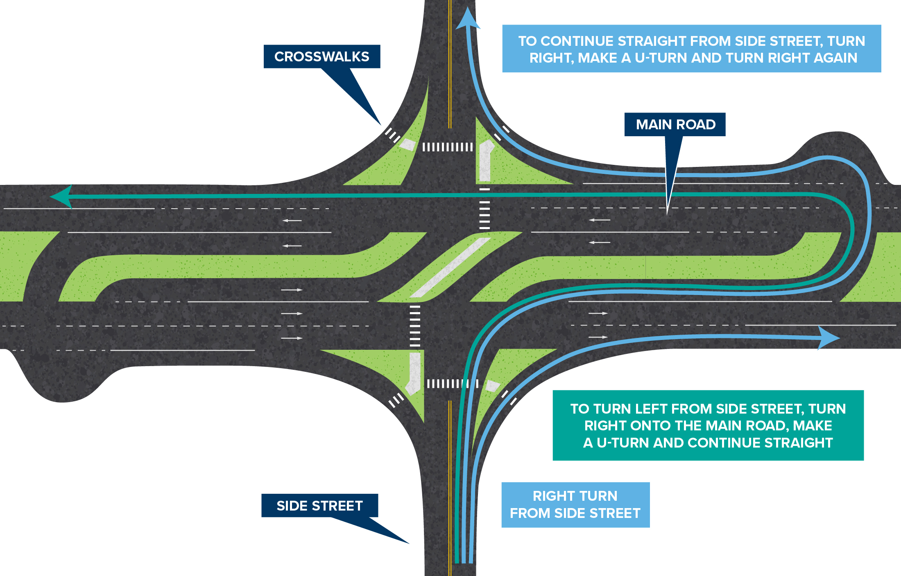
What is an RCUT Intersection?
Source: KYTC SAFERoad Solutions
Notes:
This slide is a quick overview of what an RCUT intersection is and how a vehicle travels through it. Most in attendance should know what an RCUT is, but this will be a brief overview for those who do not.
Conflicts are reduced and turning vehicles now make these movements:
- Minor road vehicles turn right as at a conventional intersection.
- Minor road vehicles travel through the intersection by first turning right, then by making a U-turn and then turning right again onto the minor road.
- Minor road vehicles turn left by first turning right, then by making a U-turn and then continuing straight.
- Left turns from the main road are typically provided.
Conflicts are separated in time and space (i.e., minor road vehicles make one movement looking in one direction at a time).
RCUT Image Source: https://transportation.ky.gov/saferoadsolutions/Pages/RCUT.aspx

Slide 4
Why Create RCUT Guidance?
Over 50 RCUT intersections have been constructed in Kentucky.
Multiple informational guides exist.
Coverage in Green Book is minimal.
MUTCD doesn’t contain an RCUT scenario.
Establish more consistent layout and presentation to motorists.
Apply along corridors and in presence of other traffic control.
Aid in designing for multiple contexts.
Notes:
Source data for number of RCUTs in Kentucky come from TRAK: https://trak.kytc.ky.gov/Innovative_Intersections
No national guidance for RCUTs exists like there is for roundabout intersections. The Green Book, over a few pages, describes RCUTs but provides no recommended design values. There are national informational guides available, such as FHWA’s Restricted Crossing U-turn Intersection Informational Guide, August 2014.
The MUTCD doesn’t specifically call out RCUT type intersections so signing, pavement markings, and traffic signal warrants have to be adapted.
This guidance, while being laid out to offer flexibility, will allow for a more consistent layout and presentation of roadway features to motorist, will also allow for the implementation of RCUT intersections over a wider range of contexts and adjacent to other traffic control types.
FHWA’s Restricted Crossing U-turn Intersection Informational Guide: https://rosap.ntl.bts.gov/view/dot/29477

Slide 5
What This Guidance Is and Is Not
Is NOT Prescriptive
More than looking up values from tables
IS Flexible
Varying site conditions
Multiple context classifications
Notes:
This guidance document was NOT developed to be prescriptive (e.g., not just looking up values from tables or charts).
Each intersection presents its own unique challenges, therefore, the guidance was developed to be adaptable to various site conditions and used in different context classifications.

Slide 6

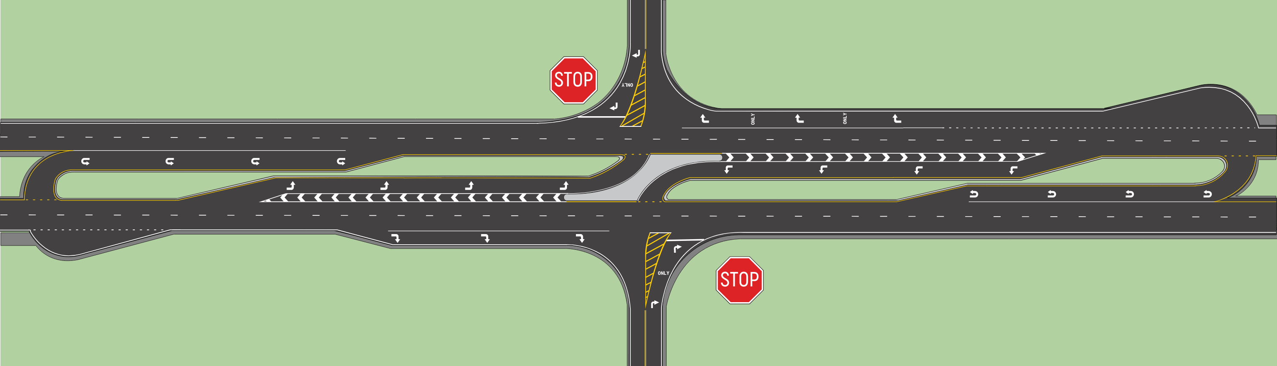
Common Terminology
Loon
Median U-turn Opening
Median U-turn Opening
Loon
Main Intersection
Notes:
This slide shows common terminology and naming conventions for RCUT elements used in the guidance document.

Slide 7
Stop-Controlled RCUT Intersection
Loon and Right-Turn Lane Connected, Preferred
Loon and Right-Turn Lane Not Connected
Source: KYTC RCUT Design Guidance, Figure 1
Notes:
The most common type of RCUT in Kentucky.
Two right turn lane options are available. 1) keeping the loon and the right-turn lane separate. 2) extending the right-turn lane back to connect to the loon. Recommended if budget available.
Note that stop signs only placed on the minor road approaches. The main road left turn and U-turn openings do not have stop signs placed.

Slide 8
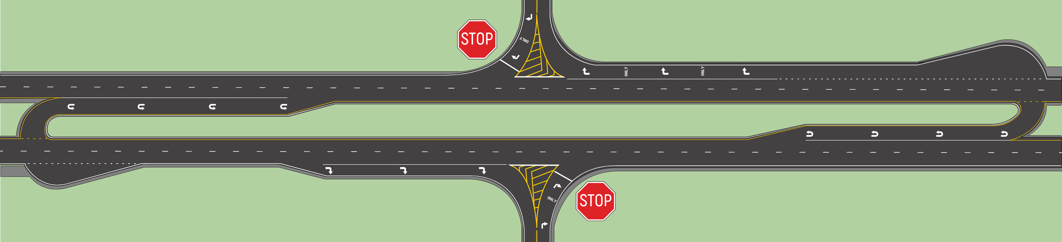
Stop-Controlled RCUT Intersection (No Main Road Left-Turn Lanes)
Source: KYTC RCUT Design Guidance, Figure 2
Notes:
Currently not in Kentucky (used in MN and WI and a few other states). Can be used at intersections with very low minor road volumes, where a constraint exists (such as unachievable ISD at the main intersection, or as part of a larger corridor management layout. If used, need to check that design and control vehicle can make the U-turn.

Slide 9
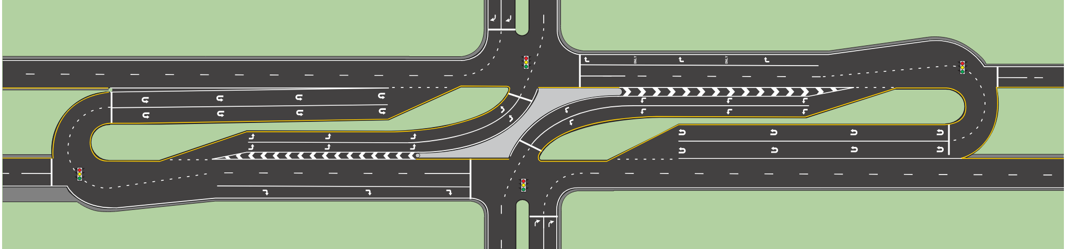
Signal-Controlled RCUT Intersection
Source: KYTC RCUT Design Guidance, Figure 3
Notes:
At signal-controlled RCUT intersections the main intersection is signalized. The loons may or may not be signalized. Pedestrians and bicyclist can more easily be accommodated at signalized RCUT intersections. Not shown, but the loon and right turn lane can also be separated.

Slide 10
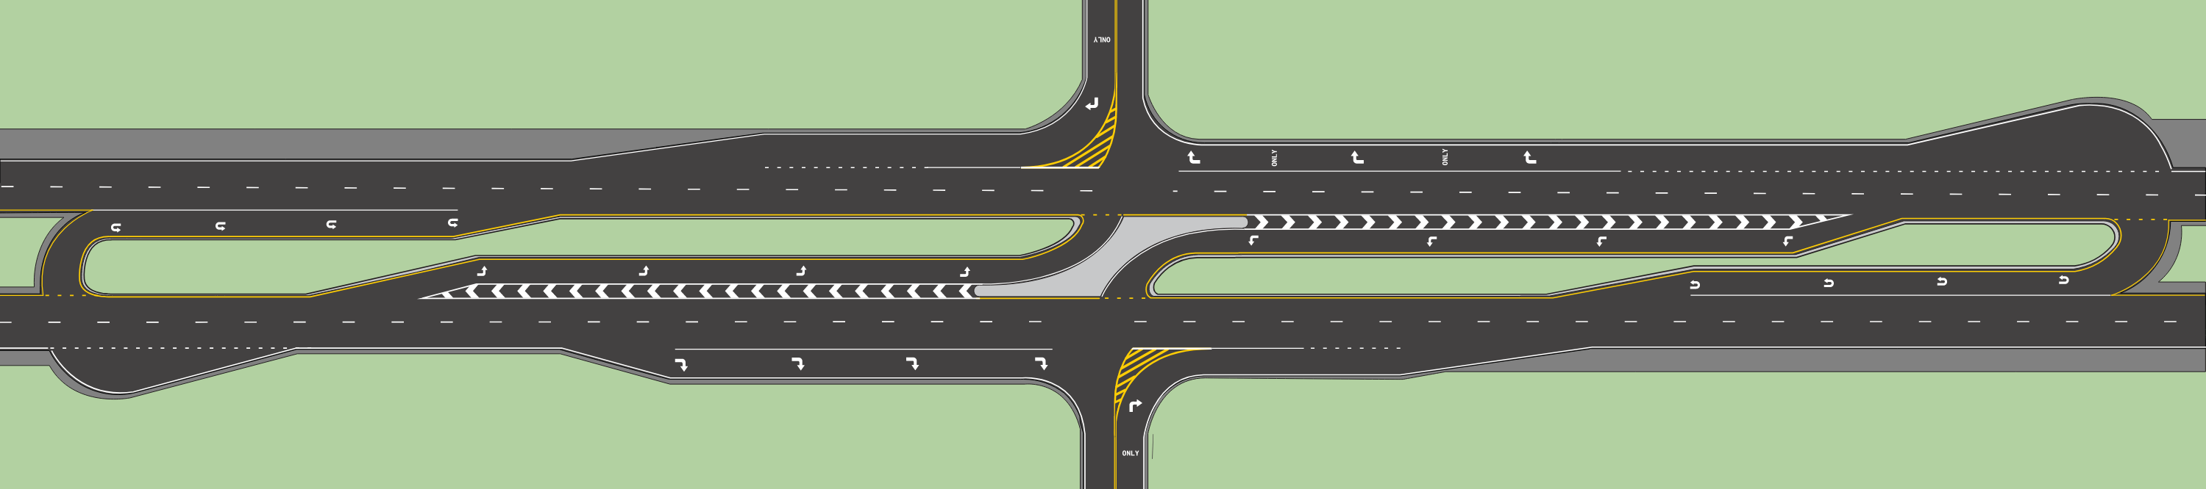
Merge-Controlled RCUT Intersection
May result in higher speeds. Check for pedestrian presence.
Source: KYTC RCUT Design Guidance, Figure 4
Notes:
This variant is also known as a Merge- (Yield-) controlled RCUT intersection. The guide covers mostly stop- and signal- controlled RCUT intersection but this is an option if an appropriate situation arises.
The merge-controlled RCUT intersection is typically only used in situations where roadway speeds are high. The merge and acceleration lanes work in place of a grade separated facility. Room is provided for minor road vehicles to accelerate to mainline speeds then decelerate into the U-turn opening. The median U-turn opening is located farther away (up to a half-mile) from the main intersection than it is in stop- or signal- controlled RCUT intersections.
Use with caution, especially where pedestrians are present.

Slide 11
Planning and Site Selection — Construction and Project Types
For new construction or reconstruction projects involving rural four-lane divided highways with wide medians, RCUT intersections are recommended as the baseline intersection type within the project area.
Also considered for Resurfacing and Restoration (2R) or Resurfacing, Restoration, and Rehabilitation (3R) projects.
Coordinate with KYTC Leadership if additional funding source needed.
If no funding source available, document need as a CHAF.
Notes:
This slide shows that on new construction or reconstruction type projects on four-lane wide median highways, RCUT is the default intersection type. Also, can be considered with 2R and 3R projects.
If the project team decides that an RCUT intersection will provide value to the project, but funding is not available coordinate with KYTC Leadership to find additional funding. If no additional funding exists, document the need as a CHAF. Coordinate with District Planning staff.

Slide 12
Planning and Site Selection
Consideration | Favorable Conditions
Access Control | Partial control or access control by permit.
# of Through Lanes | Multilane divided highways with ≥ 4 through lanes.
Median Width | ≥ 24 ft. in urban or suburban contexts ≥ 40 ft. in rural contexts
Crash Types | Angle or left-turn intersection crashes.
Traffic Volumes | Low minor road left-turn and through volumes. Minor road volume is < 20% of the total intersection volume.
Sight Distance | Minor road right-turn, major road left-turn, and major road U-turn intersection sight distance can be obtained.
U-turn Opening | Cross section width allows U-turns of design vehicles, or ROW available to construct a loon.
Peds. & Cyclists | Best accommodated at a signalized RCUT intersection.
Source: KYTC RCUT Design Guidance, Table 1, simplified.
Notes:
This table summarizes conditions that are favorable for implementing an RCUT intersection type. If a condition in this table isn’t present, it doesn’t mean that an RCUT can’t be selected. It just means that the condition may need to be mitigated for.
Example being, narrower medians will need larger loons constructed at the median U-turn openings. Another example is the median U-turn opening may need to be shifted slightly to obtain proper intersection sight distance.
KYTC RCUT Design Guidance, Table 1.

Slide 13

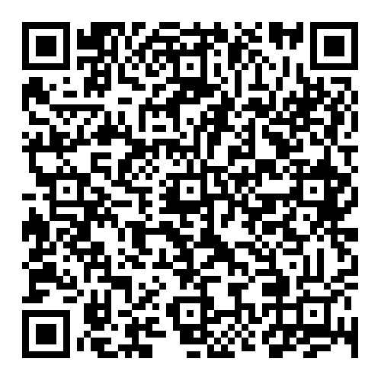
Planning and Site Selection — Intersection Control Evaluation
KYTC ICE Guidance
KYTC RCUT Design Guidance
Informed Decision Making
Notes:
When deciding if an RCUT is a viable candidate for intersection improvement, the use of the KYTC ICE Guidance when combined with using the KYTC RCUT Design Guidance will lead to more informed decision making, whether at an isolated rural intersection or when selecting traffic control types along a corridor with multiple intersections.
KYTC Intersection Control Evaluation (ICE) Guidance: https://transportation.ky.gov/Highway-Design/Documents/ICE%20Guidance.pdf
KYTC Reduced Conflict U-turn (RCUT) Design Guidance: https://transportation.ky.gov/Highway-Design/Documents/Kentucky%20RCUT%20Guidance_2026-08-21.pdf

Slide 14
Planning and Site Selection — RCUTs in Corridors
Scope the level of traffic and safety analysis early.
Consult KYTC Microsimulation Guidelines.
Most effective where minor road volumes are low.
Evaluate the corridor as an integrated system.
Analyze at least one intersection past the project area.
Consider combining with access management techniques.
Median U-turn openings can be spaced to serve multiple access points or minor roads.
Notes:
Make sure to scope the traffic and safety analysis early in the process, before a consultant contract is in place, so the needed amount of attention can be given to analyzing multiple RCUT intersections in a corridor. The Division of Planning can help with this task and with what traffic analysis tools are most appropriate for the conditions.
Evaluate the influence RCUT intersections have on adjacent intersections. Evaluate the corridor as an integrated system. Look at least one intersection past the project area if considering RCUTs in a corridor (similar to the traffic analysis study area for an IJS). Example, converting to RCUTs may dump traffic more quickly on an adjacent signalized intersection than what was there before because a series of RCUTs can move traffic more efficiently than a series of conventional signalized intersections.
RCUT intersections present an opportunity to integrate access management into a project given they provide median U-turn openings and use medians to restrict turning movements.
Where RCUT intersections are being considered in a corridor, median U-turn openings can be spaced to serve multiple access points.
KYTC Microsimulation Guidelines, 2021: https://transportation.ky.gov/Planning/Documents/KYTC%20Microsimulation%20Guidelines.pdf

Slide 15
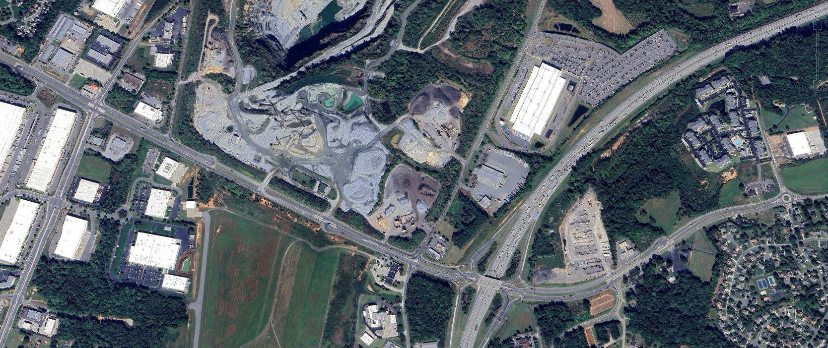
Planning and Site Selection — Arterial Corridor Example
Conventional Signalized Intersection
I-85
Double Crossover Diamond Interchange
Median U-turn Intersection
Poplar Tent Road
Signalized RCUT
Multilane Roundabout
Signalized RCUT
Source: Google Earth, near North Concord, NC
Notes:
This is an example of a suburban type arterial corridor from North Carolina that includes several different types of intersections and an interchange. The prior condition was a two-lane highway with conventional intersections and diamond interchange. An ICE analysis would be conducted, along with more detailed traffic and safety analysis. Microsimulation traffic analysis would probably be needed.

Slide 16
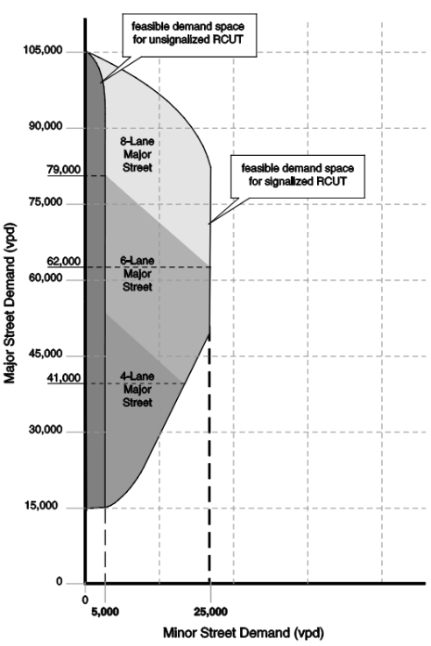
Planning and Site Selection — Demand Volumes
Approximate traffic volumes for RCUT signalization
Traffic analysis and warrants needed
Source: FHWA RCUT Informational Guide, Exhibit 5-7
Notes:
When planning and selecting a site for an RCUT intersection, Minor and Major road volume ranges for potential signalization can be checked. Exhibit 5-7 is a more generalized approach and not to be used on its own. It can help at the planning level, but more detailed analysis is needed to determine if a signalized RCUT is appropriate.
FHWA’s Restricted Crossing U-turn Intersection Informational Guide: https://rosap.ntl.bts.gov/view/dot/29477

Slide 17
Safety Analysis
Thirteen Kentucky RCUT intersections reviewed.
At least three years of before-and-after crash data per site.
47% reduction in overall crashes, 65% reduction in angle crashes.
Source* | Star Quality Rating | Situation | CMF – All Crashes | CMF – Fatal & Injury Crashes
CMF ID: 5555 & 5556 (2013) | ,  | Rural Two-way Stop-Controlled to RCUT | 0.652 | 0.463
CMF ID: 9984 & 9985 (2017) | ,  | Suburban Signalized Intersection to Signalized RCUT | 0.85 | 0.78
CMF ID: 4883 & 4884 (2010) | ,  | Rural Unsignalized Intersection to Unsignalized RCUT | 0.54 | 0.37
*Source: FHWA Crash Modification Factors Clearinghouse
Notes:
The bullet points summarize the intersection safety analysis conducted as part of the Kentucky RCUT Design Guidance development. Kentucky RCUT intersections seem to be operating similar to what CMFs have shown nationally.
FHWA Crash Modification Factors Clearinghouse: https://cmfclearinghouse.fhwa.dot.gov/index.php

Slide 18
Design Vehicles
Largest vehicle type expected to execute the turning movement with noticeable frequency.
Specific to each turning movement
Account for site-specific conditions (school entrance, fire station, unique traffic generator).
Design vehicle should not encroach upon curbs, raised channelization, raised islands, raised medians, or enter opposing traffic lanes.
Notes:
Specific to each turning movement is called out since different design vehicles may be selected for each turning movement. Example being the U-turn location will typically have two design vehicles.

Slide 19
Design Vehicles
Can select a control vehicle for infrequent user
  Locate signs, drainage boxes, headwalls, curbs, etc. outside turning path.
Conduct an Autoturn analysis for the design and control vehicle.
Retain output files in design file.

Slide 20
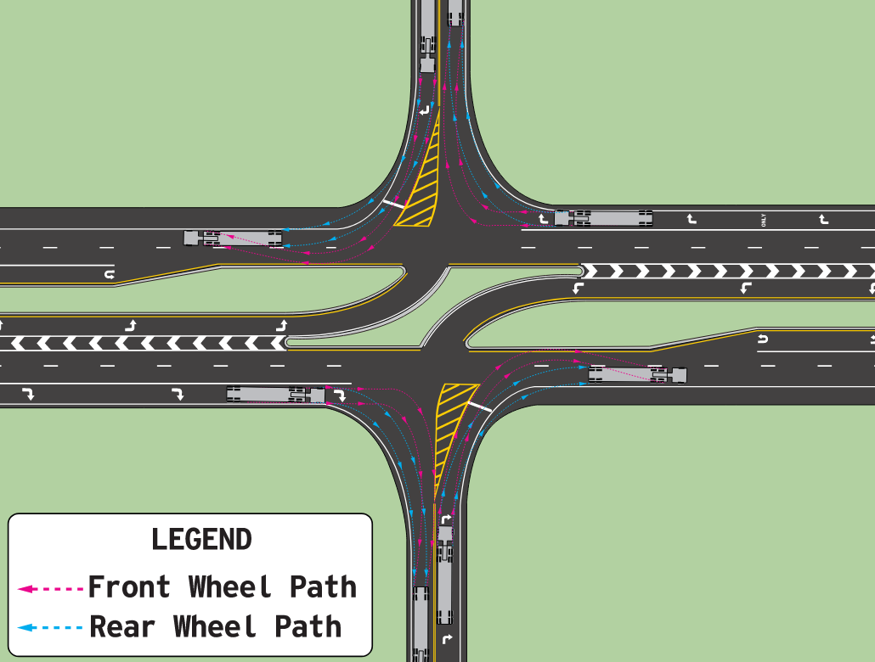
Stop-Controlled Right-Turn Design Vehicle
Design Vehicle
WB-67
Source: KYTC RCUT Design Guidance, Figure 14
Notes:
The recommended design vehicle for right turns into and out of the minor road is a WB-67.
Not to encroach into curbing, drainage boxes, raised channelization, raised islands, median islands, opposing traffic lanes.

Slide 21
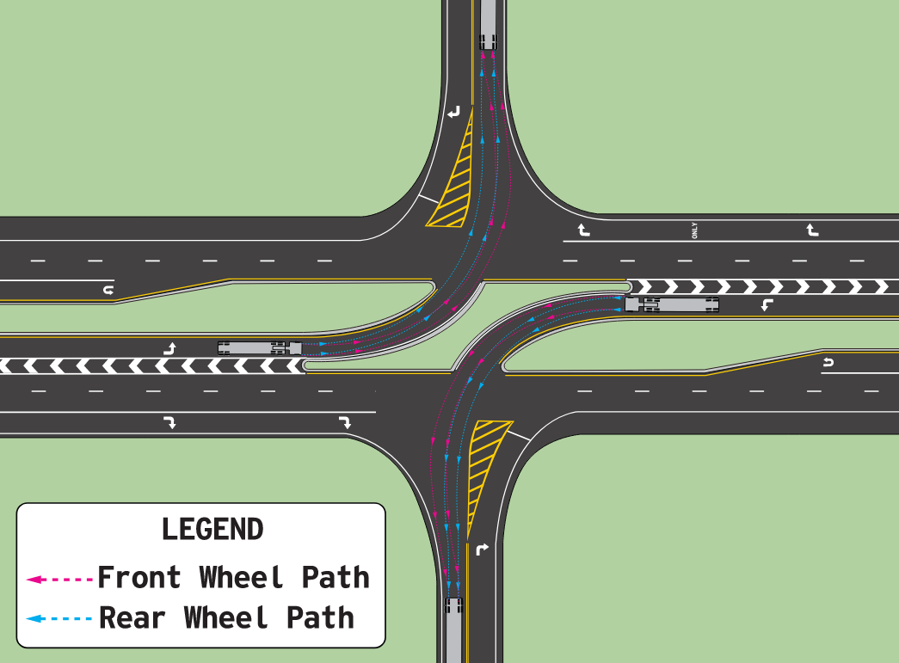
Stop-Controlled Left-Turn Design Vehicle
Design Vehicle
WB-67
Source: KYTC RCUT Design Guidance, Figure 15
Notes:
The recommended design vehicle for turning left from the main road is a WB-67.
Not to encroach into curbing, drainage boxes, raised channelization, raised islands, median islands, opposing traffic lanes.

Slide 22
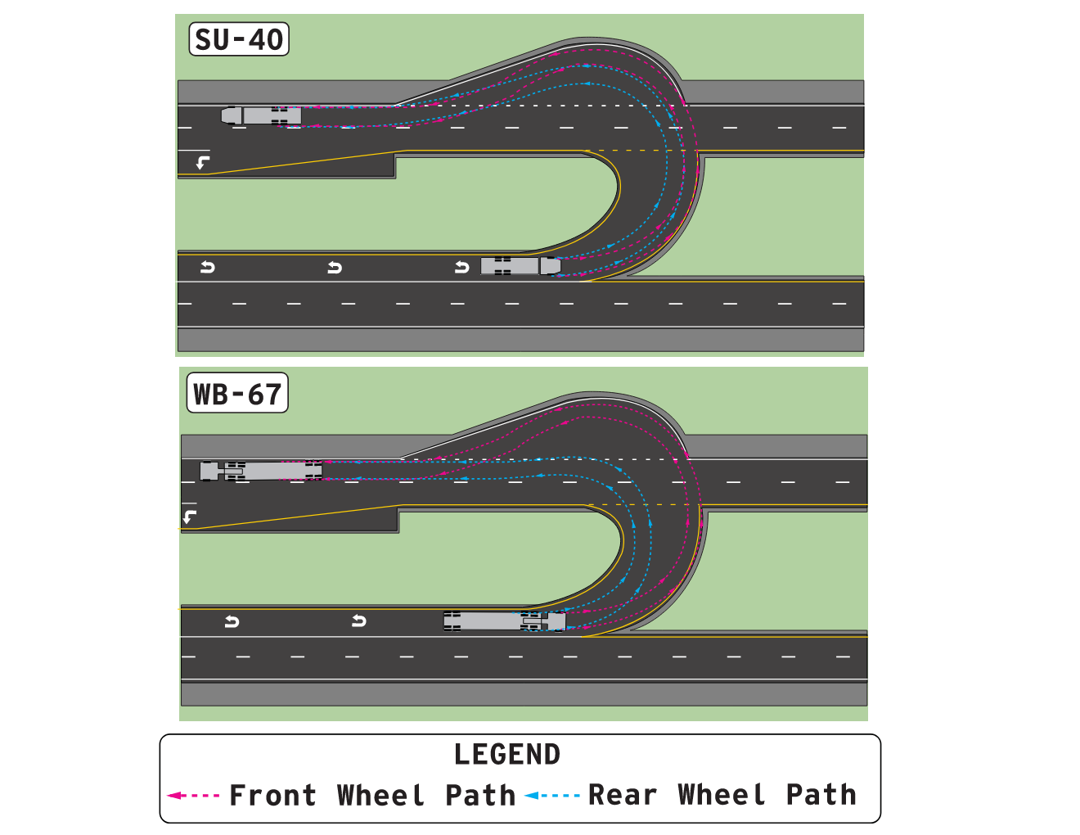
Stop-Controlled U-turn Design Vehicle
Single-lane U-turn | Dual U-turn
WB-67 (inside path), SU-40 (outside path) | P (inside lane), WB-67 (outside lane)
Source: KYTC RCUT Design Guidance, Figure 16
Notes:
The recommended design vehicles for a single-lane median U-turn opening is a WB-67 (for inside path) and a SU-40 (for outside path).
Where dual U-turn lanes are present, at a minimum use a P (passenger car) for the inside lane design vehicle, and a WB-67 for the outside lane. Given frequency of vehicle types that use the dual U-turn may need a larger inside lane design vehicle.
Not to encroach into curbing, drainage boxes, raised channelization, raised islands, median islands, opposing traffic lanes.

Slide 23
Intersection Sight Distance
Location | Intersection Sight Distance Method
Stop-Controlled: Minor Road Right-turn | AASHTO Case B2 (Section 9.5.3.2.2)*
Stop-Controlled: Major Road Left-turn | AASHTO Case F (Section 9.5.3.6)*
Stop-Controlled: Median U-turn | GaDOT U-turn Research Report 23-03
Traffic Signal | AASHTO Case D (Section 9.5.3.4)*, MUTCD**
Provide clear sight triangles at each location
Check for both passenger car and truck drivers
*Source: AASHTO Green Book, 7th Edition **Source: MUTCD Section 4D.06, 11th Edition
Notes:
This is a general overview of Intersection Sight Distance to provide at an RCUT intersection.
Check for minor road right-turn, major road left-turn, and major road U-turn. Each location separately. Provide clear sight triangles at each turning movement location.
Check BOTH passenger and truck design vehicles at each location. Passenger car eye height = 3.5 ft, truck driver eye height = 7.6 ft. Object height 3.5 ft.
Use equation 9-1 out of the Green Book to calculate the ISD length. Make sure to add adjustments to the time gap if needed.
Provide a clear sight triangle at each of these locations. With a signalized RCUT intersection, in addition to AASHTO Case D there are also MUTCD traffic signal visibility requirements.
Georgia DOT Research Project 23-03: https://g92018.eos-intl.net/eLibSQL14_G92018_Documents/23-03.pdf
MUTCD, 11th Edition: https://mutcd.fhwa.dot.gov/pdfs/11th_Editionr1/mutcd11theditionr1hl.pdf

Slide 24
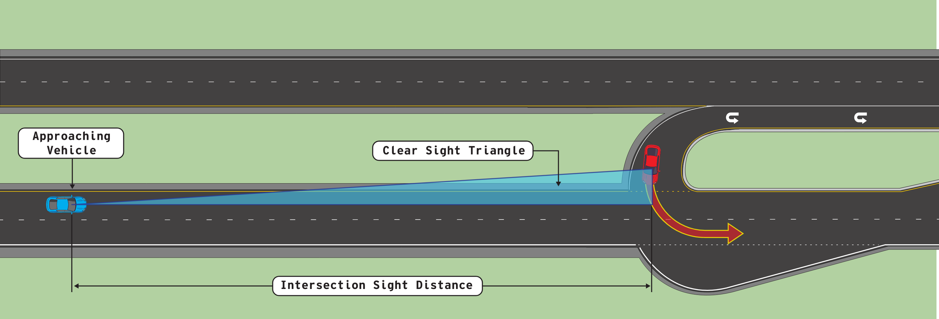
Stop-Controlled U-Turn Sight Distance
No AASHTO intersection sight distance case.
Use method developed by GaDOT: Georgia DOT Research Project 23-03
Source: KYTC RCUT Design Guidance, Figure 21
Notes:
U-turn intersection sight distance is to be checked using the method developed for the Georgia Department of Transportation. Check for both passenger car and truck design vehicles.
Georgia DOT Research Project 23-03: https://g92018.eos-intl.net/eLibSQL14_G92018_Documents/23-03.pdf

Slide 25
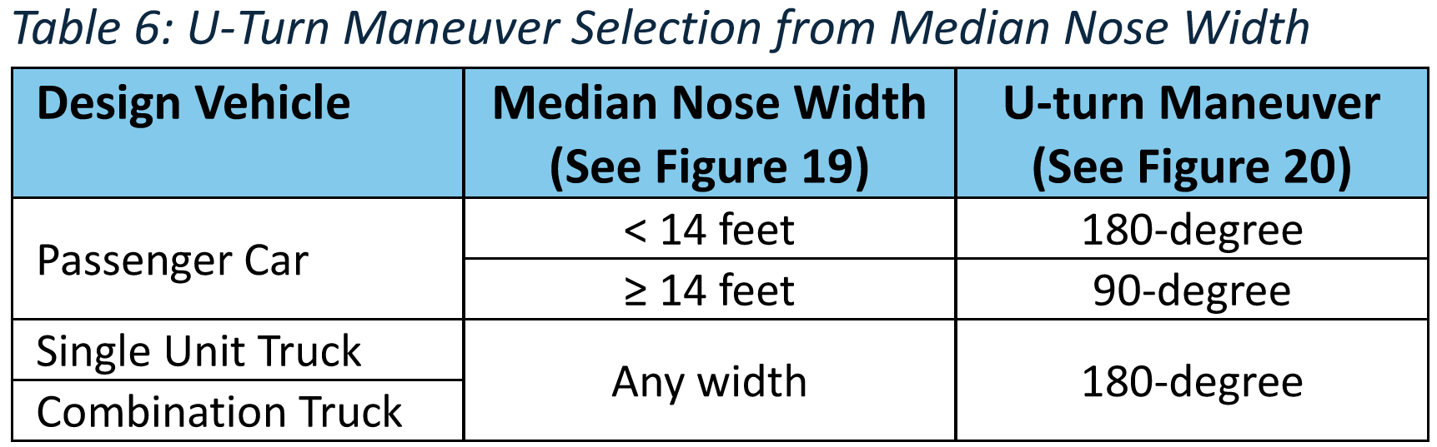
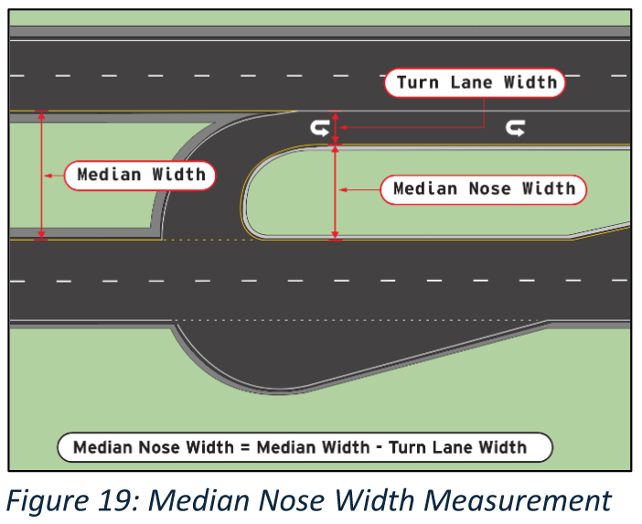
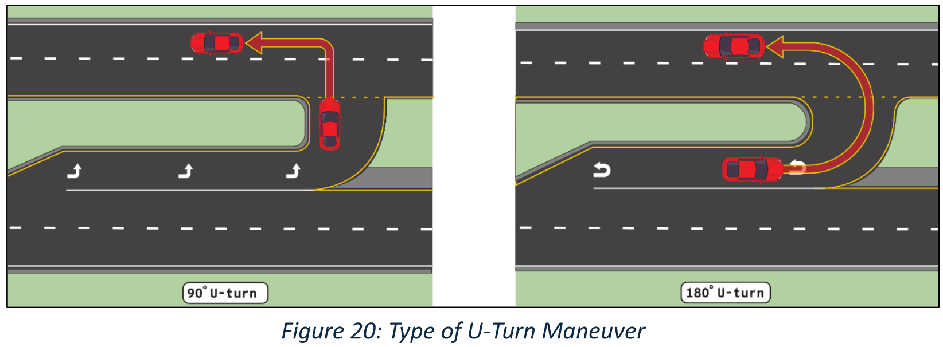
Stop-Controlled U-Turn Sight Distance
Step 1: Select design vehicle.
Step 2: Determine if 90-degree or 180-degree turn.
Notes:
Vehicles making a 90-degree U-turn operate more like a left turning vehicle. Given the size of a single unit truck or combination truck they operate more like a full 180-degree u-turning vehicle.

Slide 26
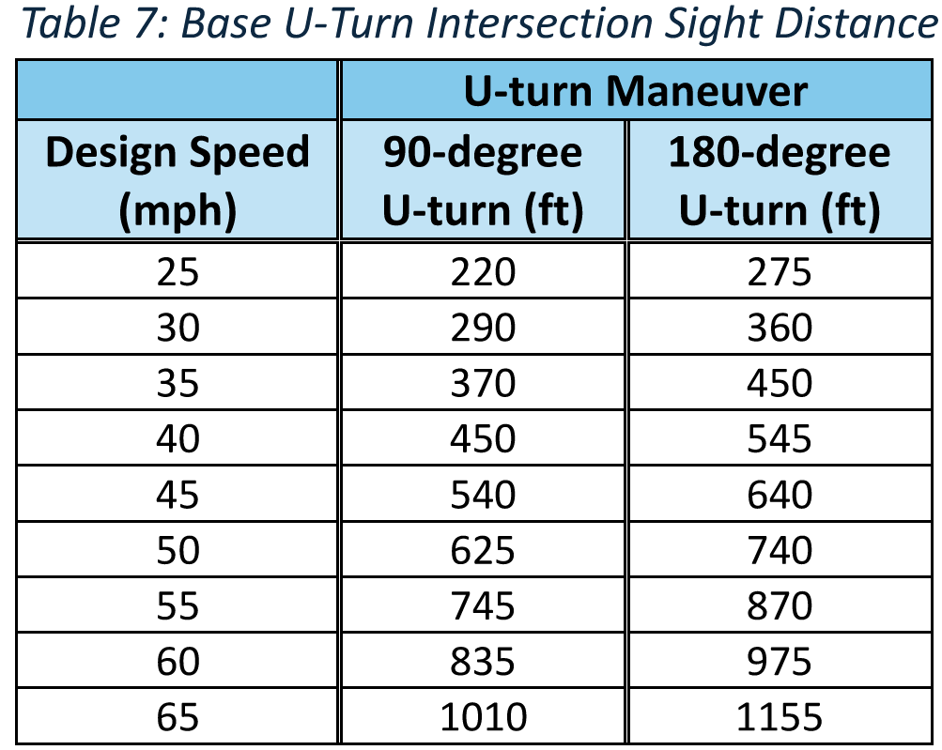
Stop-Controlled U-Turn Sight Distance
Step 3: Select base U-turn ISD from Table 7 using main road design speed and U-turn maneuver type.
Notes:
The 45mph to 65mph rows will be most common.

Slide 27
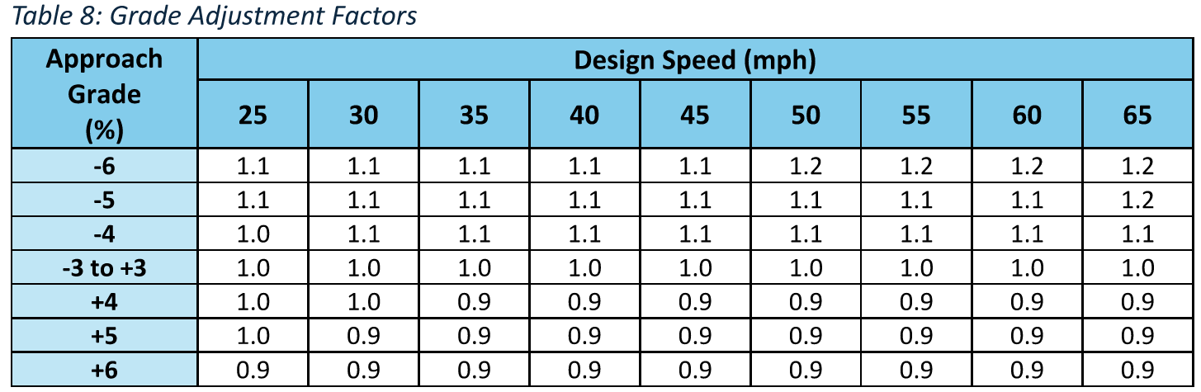
Stop-Controlled U-Turn Sight Distance
Step 4: Apply approach grade adjustment factor from Table 8 to base ISD value.
Notes:
The adjustment factor is applied to the segment of roadway approaching the median U-turn opening. A negative grade would be a grade coming down to the U-turn opening and a positive grade would be coming up to the U-turn opening.

Slide 28
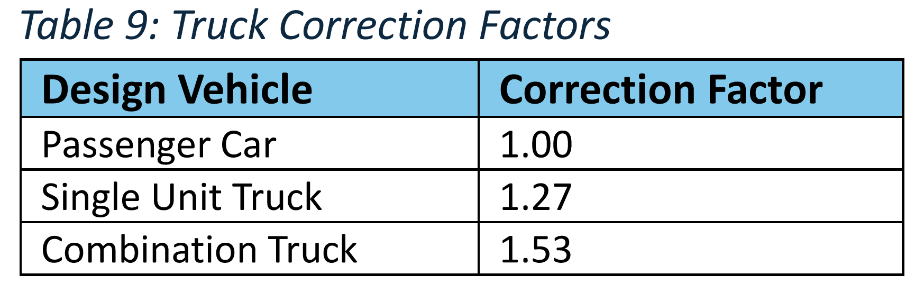
Stop-Controlled U-Turn Sight Distance
Step 5: Apply Table 9 correction factor to the grade-adjusted ISD value if single unit truck or combination truck.
Notes:
The GaDOT U-turn ISD study did not calculate the time it took single unit or combination trucks to make a U-turn. Rather, they used the differences in unadjusted time gaps from the Green Book to set these truck correction factors.

Slide 29
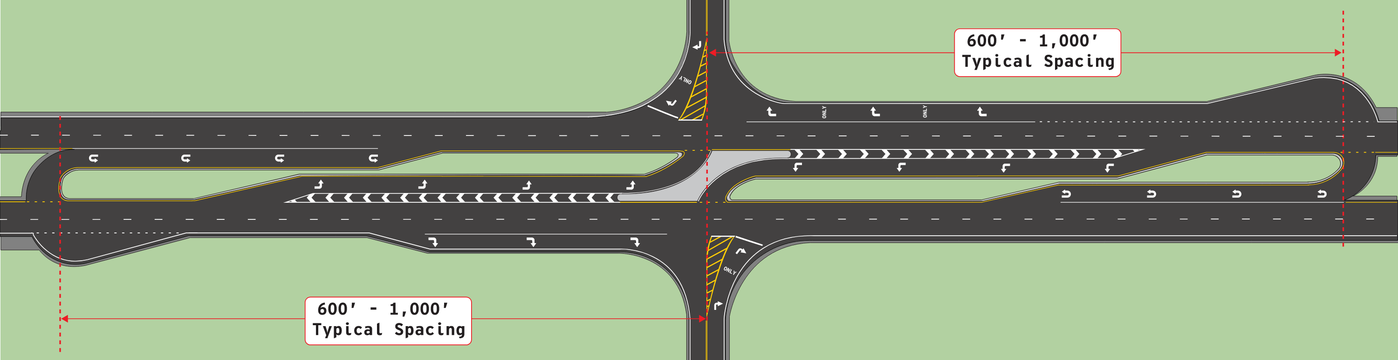
Stop-Controlled and Signalized
Median U-turn Spacing
Measured from minor road intersection point to inside of U-turn lane
Source: KYTC RCUT Design Guidance, Figure 22
Notes:
The median U-turn opening is located typically 600’ to 1,000’ from the minor roadway. Measured from the minor road intersection point to the inside of the U-turn lane.
This seems to be the number one question asked by practitioners.

Slide 30
Median U-turn Location Factors
U-Turn and Left-Turn Lane Lengths | Space median U-turn opening to accommodate deceleration and storage lengths.
Median Width | Wider medians allow overlap in U-turn and left-turn lanes, shortening distances.
Intersection Sight Distance | Adjust location to achieve U-turn ISD. Consider horizontal and vertical geometry and other sight obstructions.
Feature Avoidance | Avoid placing a U-turn (and loon) where a bridge, box culvert, utility, or other immovable roadside feature is present.
Superelevation | Avoid locating a U-turn with a loon in a superelevated section. This increases grade differences at the loon’s far edge.
ROW Restriction | Adjust a U-turn with a loon location where ROW is constrained.
Driveway/Access Point | Adjust U-turn to avoid entrance or access points (see Section 6.10).
Partial Access Control | Move closer to the main intersection to allow spacing between adjacent RCUT median U-turn openings.
Source: KYTC RCUT Design Guidance, Table 10, simplified.
Notes:
Factors used to select the median U-turn opening location. At a minimum the distance would provide turn lane deceleration and storage lengths.
Table 10 from KYTC RCUT Design Guidance document.

Slide 31
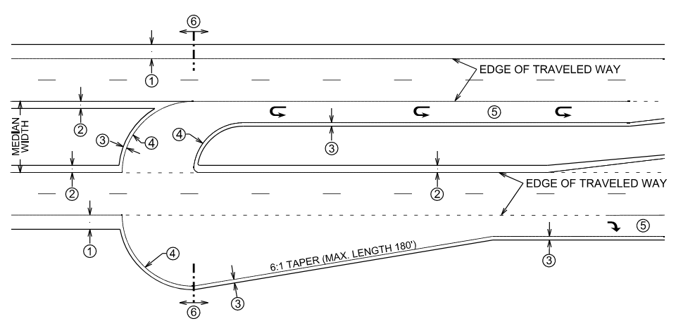
Single-Lane Loon Design
If access is provided within 100 ft. upstream or downstream, provide a raised island in median.
Radius determined by design vehicle
2 ft. Paved Shoulder (1 ft. Minimum)
Tapered design preferred
Source: KYTC RCUT Design Guidance, Figure 26
Notes:
The inside and outside U-turn radius set by the design vehicle.
Provide a 2’ paved shoulder (1’ minimum) through the U-turn. On low-speed facilities curb and gutter can be used (2’ gutter pan).

Slide 32
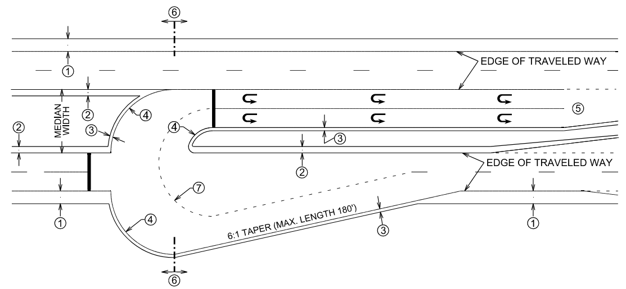
Dual U-turn Loon Design
P design vehicle inside lane shown.
WB-67 design vehicle outside lane shown.
Can restrict vehicle types by appropriate signing.
Separate right-turn lane shown, can connect to right-turn lane
Source: KYTC RCUT Design Guidance, Figure 27
Notes:
The inside and outside U-turn radius set by the design vehicle. At a minimum the inside lane is set by a Passenger Car (P), and the outside lane is set by a WB-67. Larger design vehicles can be used if commonly observed. Can also restrict trucks by signing.
Provide a 2’ paved shoulder (1’ minimum) through the U-turn. On low-speed facilities curb and gutter can be used (2’ gutter pan).

Slide 33
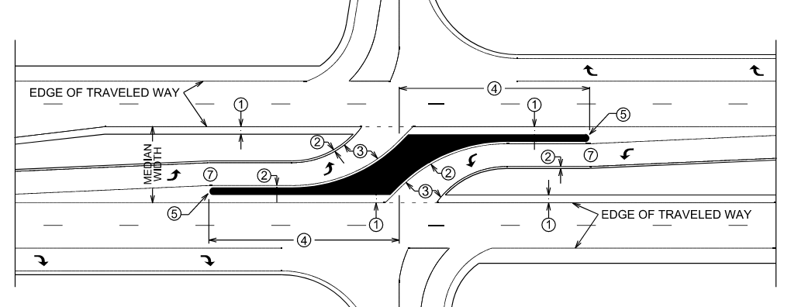
Main Intersection Channelization
Raised Channelization 100 ft. Preferred (50 ft. Min.)
If 50 mph or greater, provide 4 ft. min. offset.
If 45 mph or less, provide 2 ft. offset (1 ft. min.).
Source: KYTC RCUT Design Guidance, Figure 29
Notes:
Provide a raised island at the main intersection. It should be at least 100’ in length either side of the main intersection, 50’ minimum in either direction.
The raised channelization should be offset from the mainline lanes a minimum of 4’ where speeds are 50 mph or greater or 2’ (1’ min) where speeds are 45 mph or less.

Slide 34
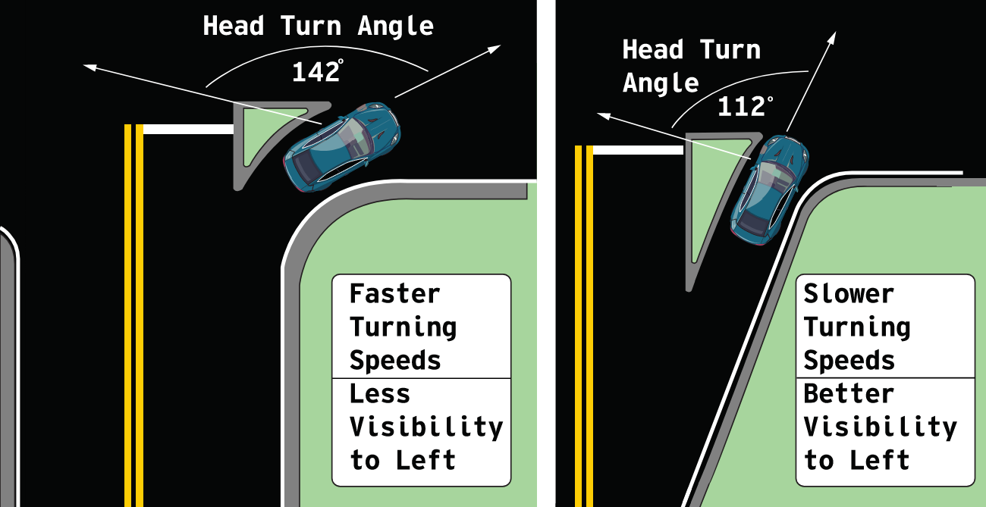
Minor Road Channelization
At non-signalized RCUT intersections, painted minor road channelization preferred over raised.
Preferred minor road approach design
Source: KYTC RCUT Design Guidance, Figure 30
Notes:
At the minor road approach, painted islands are preferred over raised islands. Minor road approaches that provide less of a head turning angle to the driver are preferred over those that cause the driver to have to turn their heads more. These angles also provide a smaller right turn radius and encourage slower turning speeds. A paved and striped area can be provided for truck overtracking on the inside of the right turn area.

Slide 35
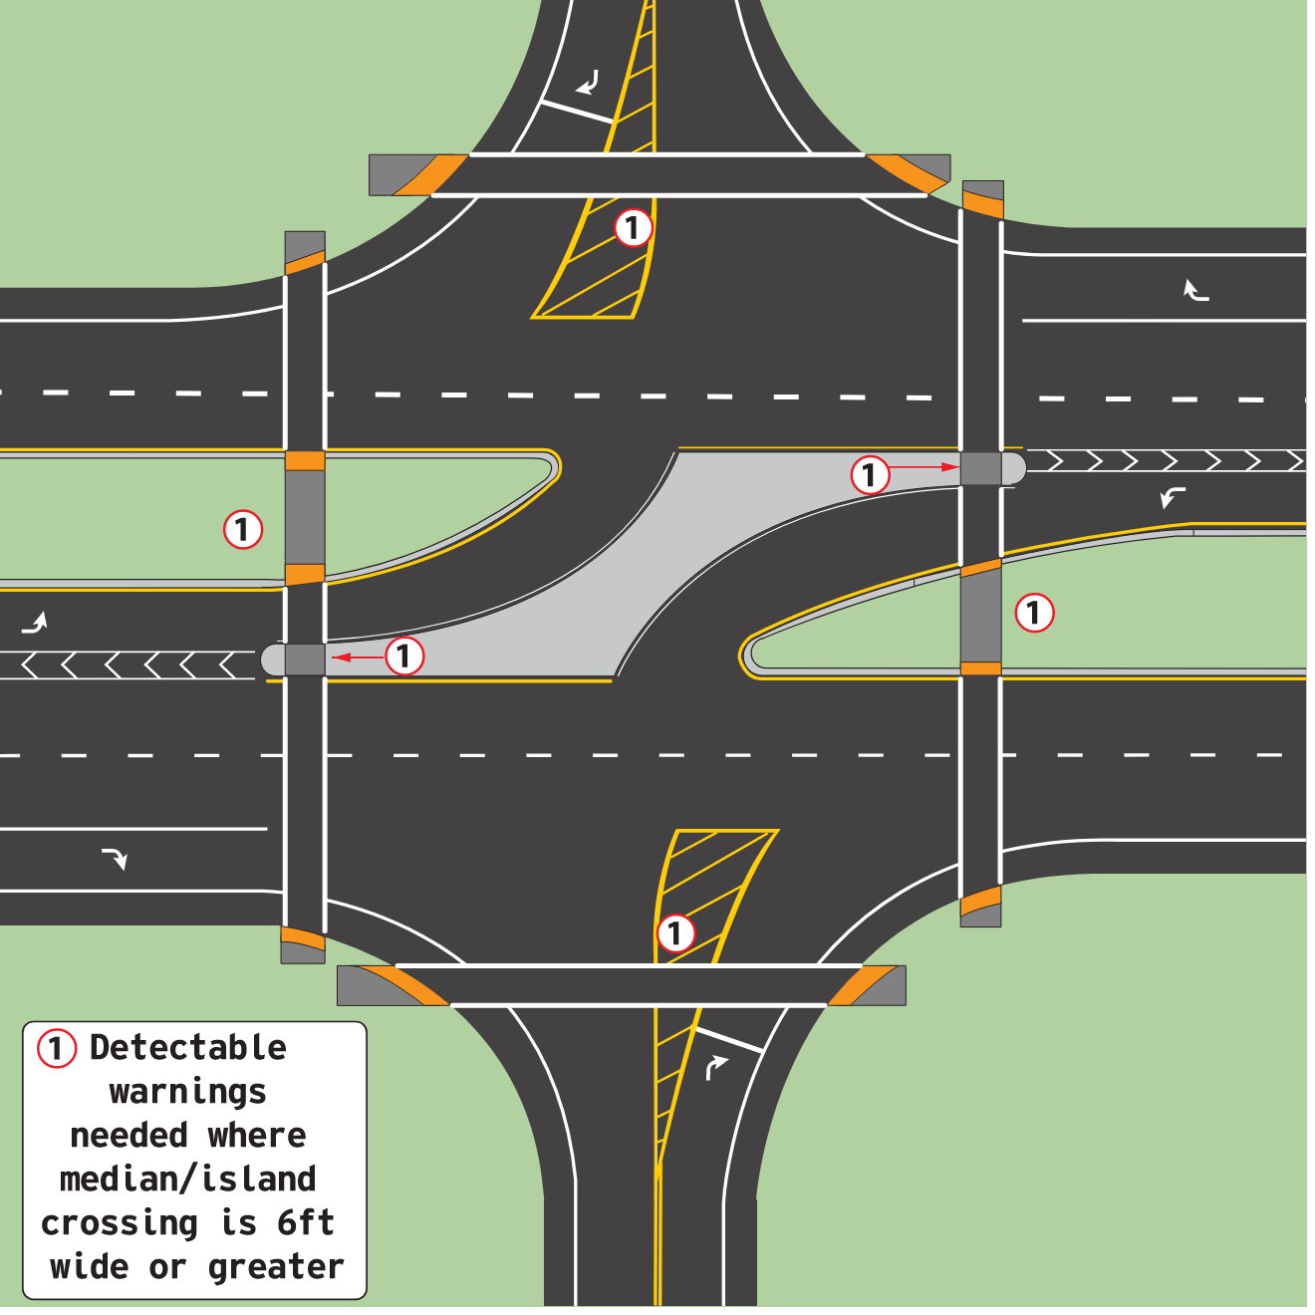
Stop-Controlled RCUT Pedestrian Accommodations
Project team decides whether to provide pedestrian accommodations
If provided, consider direct pedestrian crossing.
Source: KYTC RCUT Design Guidance, Figure 8
Notes:
Pedestrian accommodations are typically NOT provided at stop-controlled RCUT intersections. However, if the project team elects to provide pedestrian accommodations, the use of a direct crossing pattern is preferred.

Slide 36
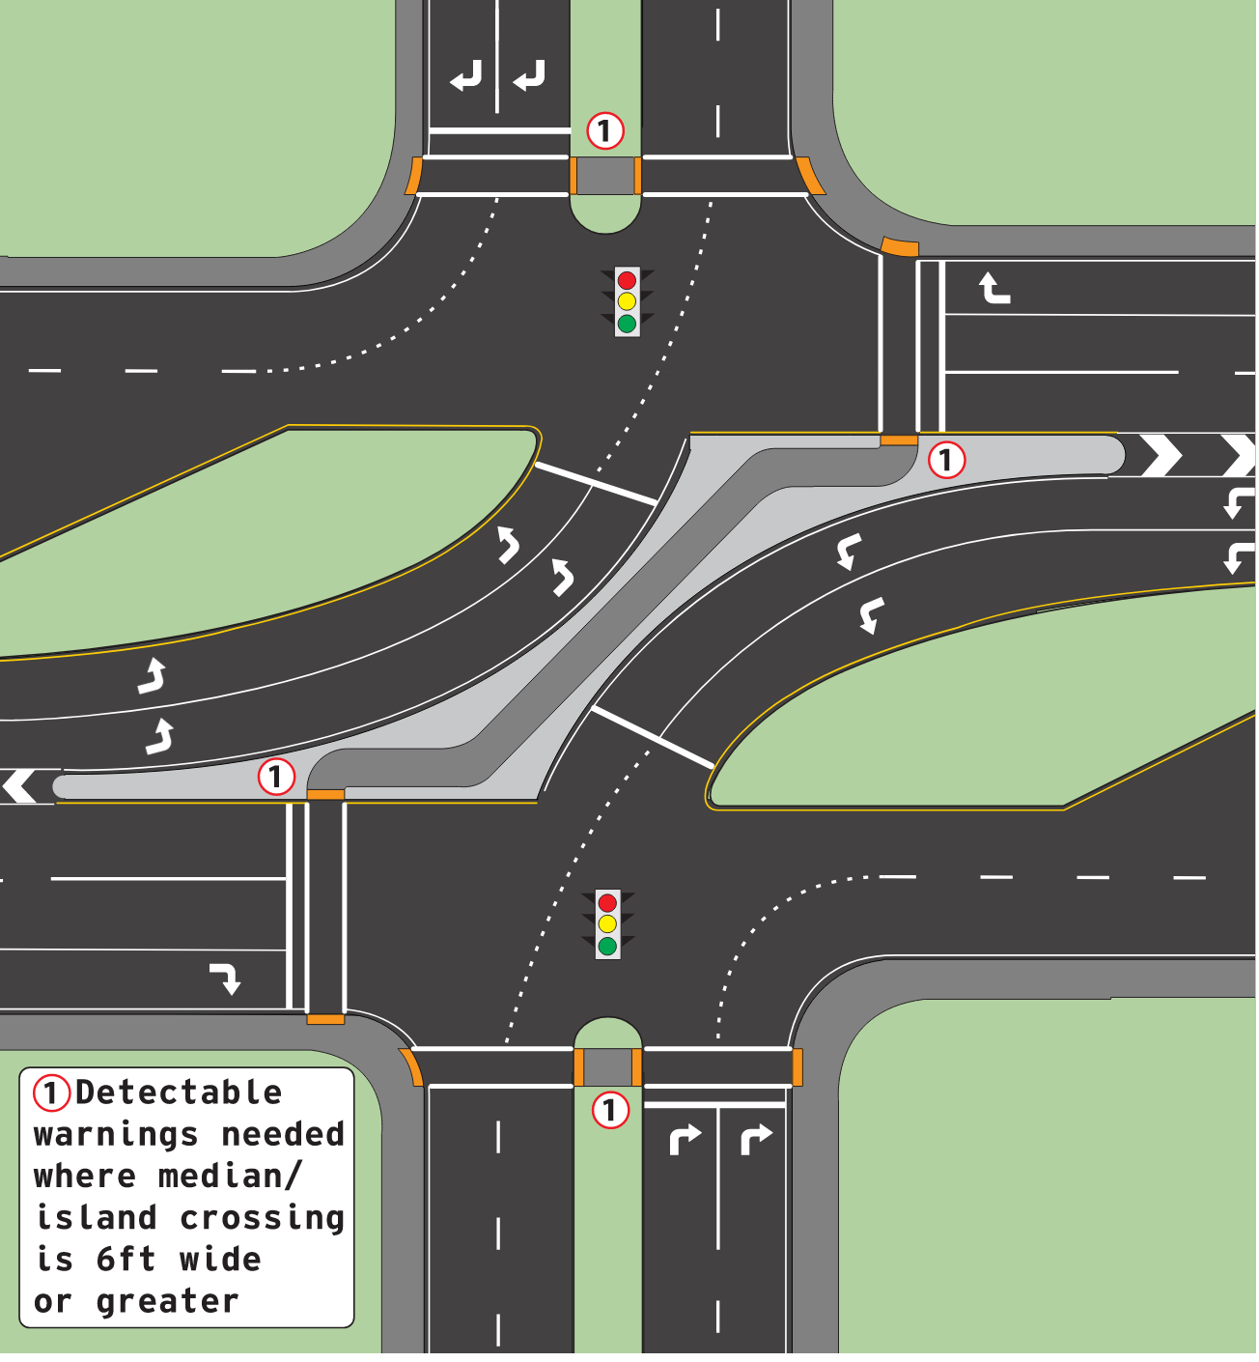
Signalized RCUT Pedestrian Accommodations
Z-Type pedestrian crossing preferred configuration at signalized RCUT intersections.
Two-stage crossing of main road
Source: KYTC RCUT Design Guidance, Figure 9
Notes:
At signalized RCUT intersections the Z-type crossing is preferred. From above this crossing pattern resembles the letter Z.
Crossing the minor road is no different than a conventional intersection. Going from upper right to lower left (or lower left to upper right) is a more direct path, but if the pedestrian needs to cross from upper left to lower right (or lower right to upper left) the crossing path is longer. Aligning the ramps and detectable warnings in the proper direction can aid visually impaired pedestrians.

Slide 37
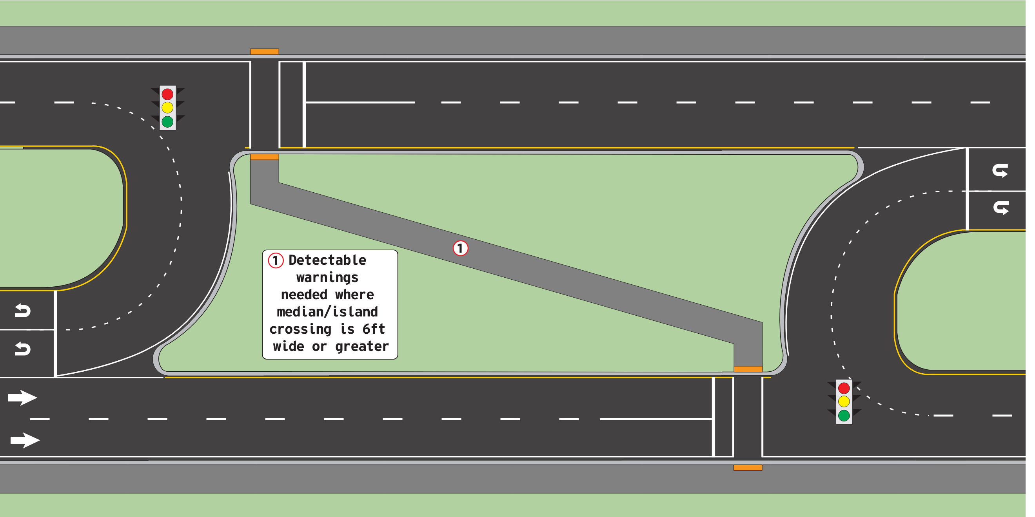
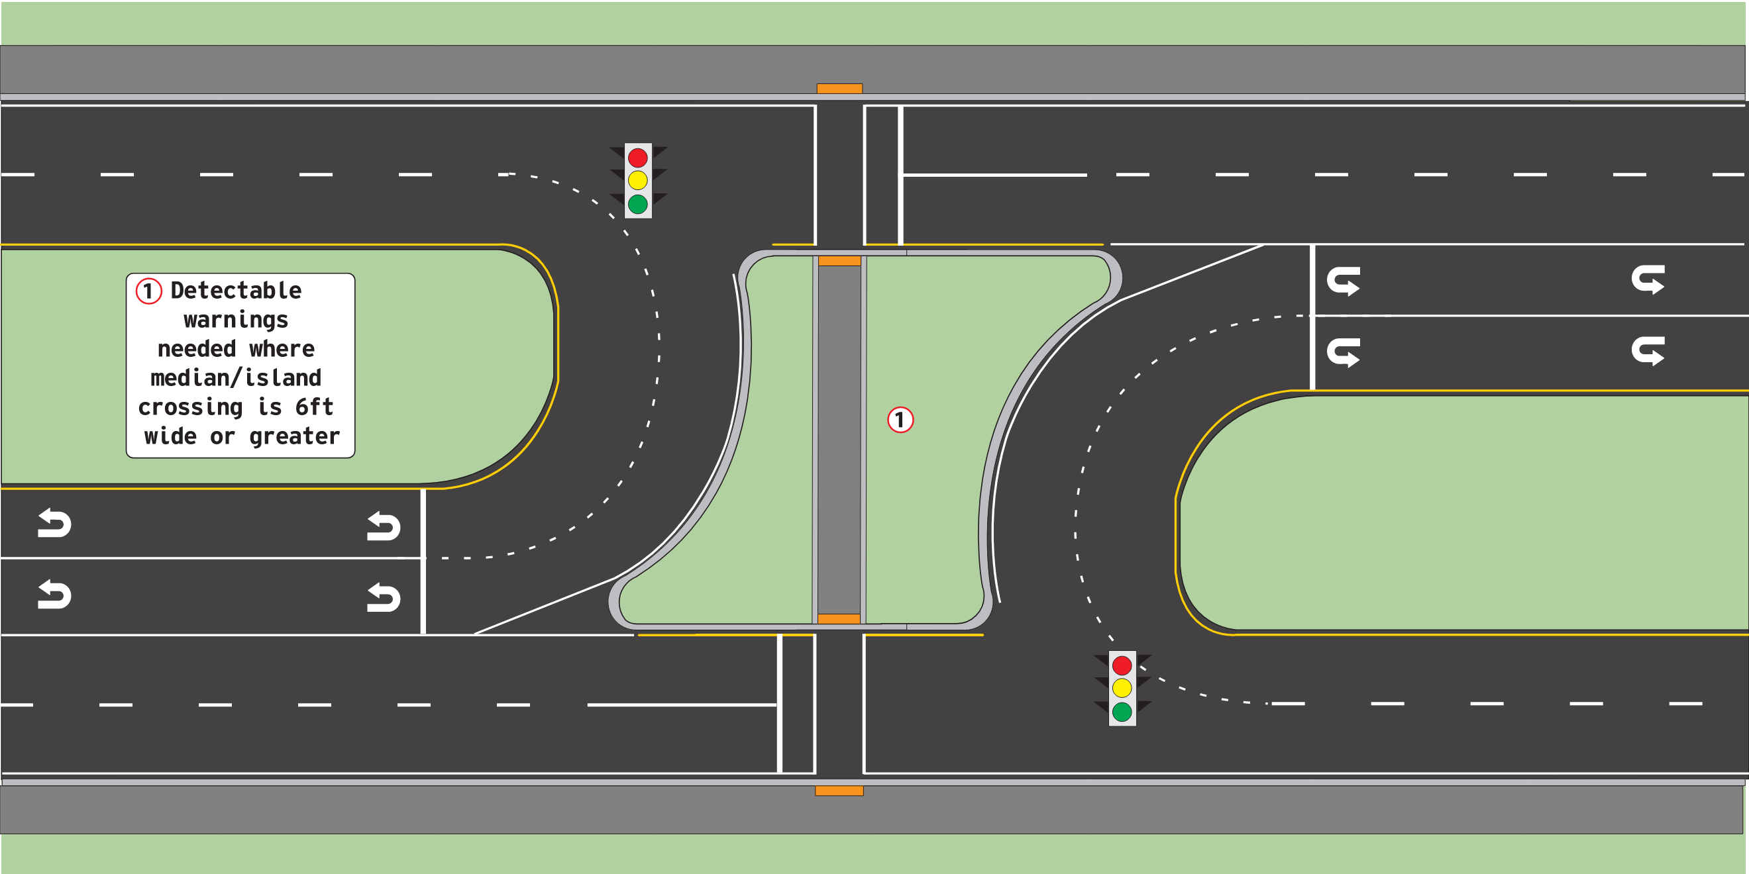
Signalized U-turn Pedestrian Accommodations
Signalized U-turn locations provide additional pedestrian crossing opportunities.
Source: KYTC RCUT Design Guidance, Figure 12
Notes:
At signalized U-turn locations additional pedestrian accommodations can be provided. This is helpful in more urbanized areas because more pedestrian crossing locations can be provided than a conventional signalized roadway corridor.

Slide 38
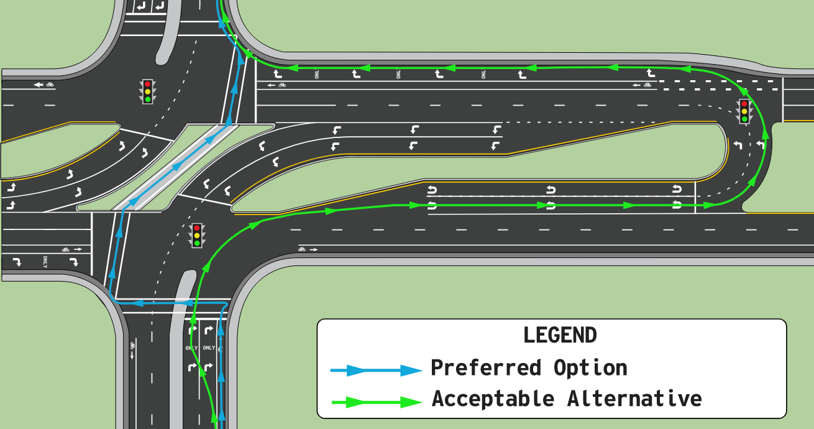
Bicycle Accommodations
Source: KYTC RCUT Design Guidance, Figure 13
Notes:
If dedicated bicycle facilities are provided on the main roadway, for the through movement bicyclist use the bike lane as they usually do. To turn right or left they move into the appropriate lane.
A shared use path would cross the roadway like a pedestrian facility.
If dedicated bicycle facilities are provided on the minor roadway and if pedestrian facilities are provided it is preferred for the bicyclist to dismount and use the pedestrian facilities. It is also acceptable for the bicyclist to if wanting to “turn left” or go “through” the intersection to merge into the proper lane, turn into the U-turn lane and then either turn right to continue on the minor road or enter the bike lane to continue through.

Slide 39
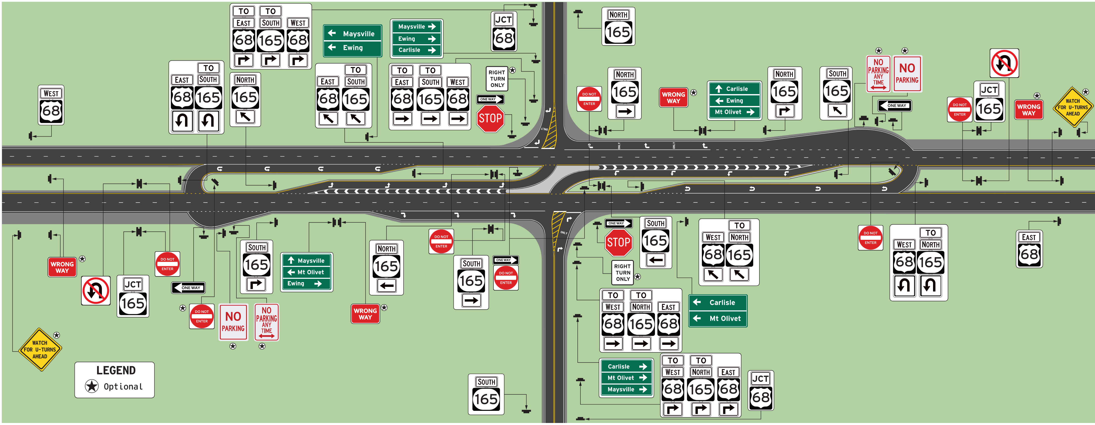
Typical Rural Stop-Controlled Signing
Source: KYTC RCUT Design Guidance, Figure 32
Notes:
Reminder to use Figure 32 for signing guidance and Figures 33 and 34 for markings guidance. Other Figures in the Guidance Document include some signs and some markings but they may not include all details shown on Figure 32-34.
Figure 32 in the Guidance Document shows typical regulatory, warning, and guide signs for an isolated, rural RCUT intersection where two state maintained roadways intersect. For many RCUTs the side street will not be a state numbered route. In those cases, there will be fewer guide signs, and you should use street names in lieu of route signs. Follow TOGM for guidance selecting cities and towns on destination signs.
Consult the Traffic Operations Guidance Manual and the MUTCD for further guidance on sign placement.
Watch for U-turns Ahead (optional)
No Parking signs (Optional)
Manual on Uniform Traffic Control Devices, current edition (MUTCD): https://mutcd.fhwa.dot.gov/kno_11th_Editionr1.htm
KYTC Traffic Operations Guidance Manual, current edition: https://transportation.ky.gov/Organizational-Resources/Policy%20Manuals%20Library/Traffic%20Operations.pdf

Slide 40
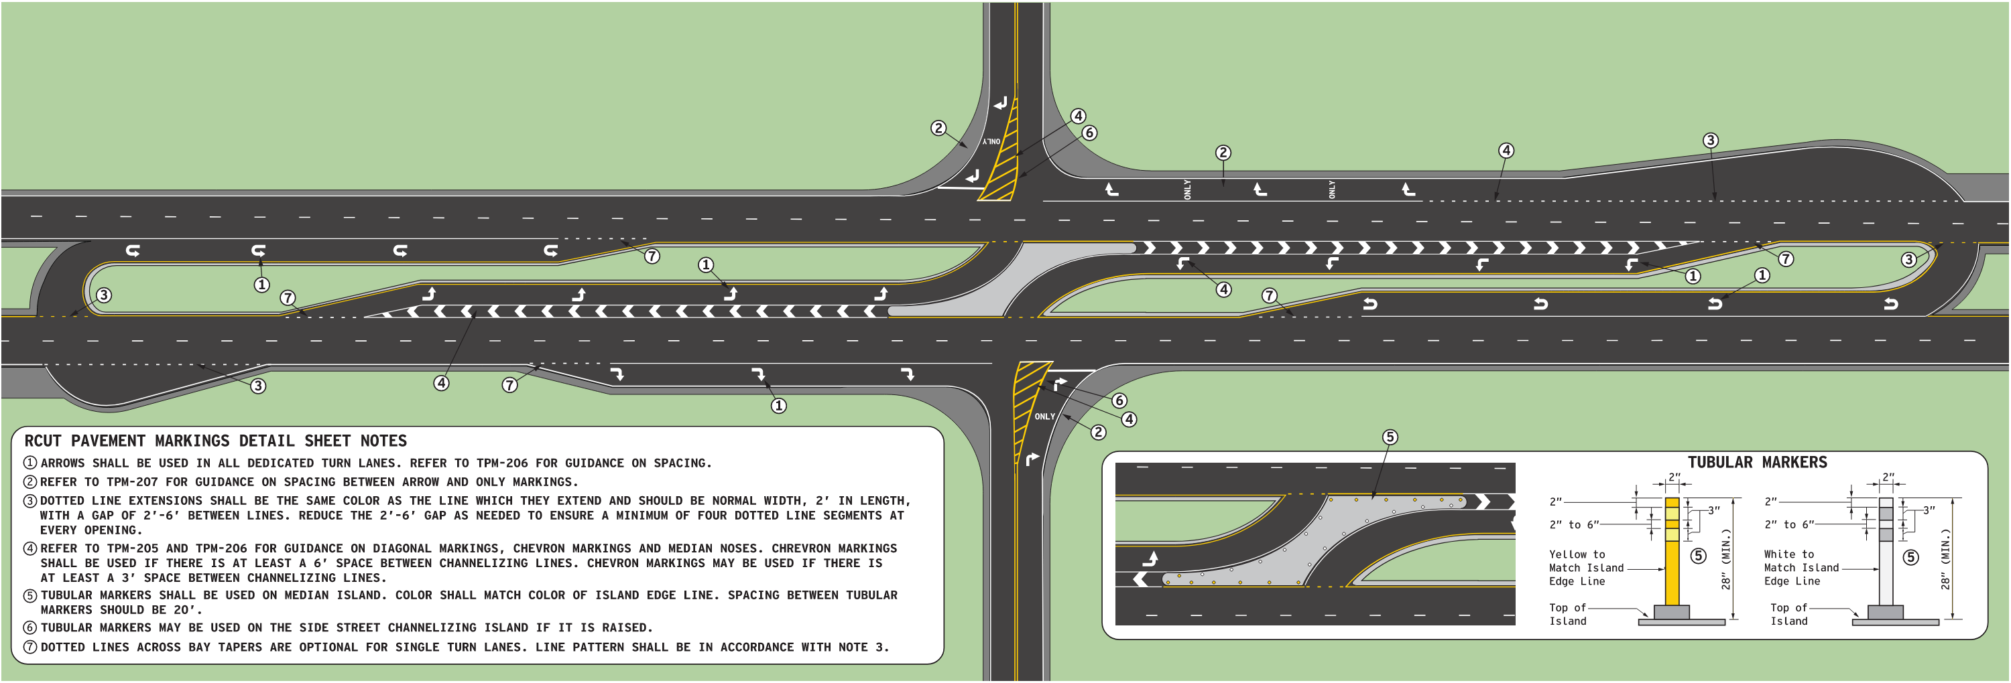
Rural Stop-Controlled Pavement Markings
Dotted Line Extensions Optional
Dotted Line Extensions Required
Dotted Line Extensions Optional
Dotted Line Extensions Required
See TPM-205 & TPM-206 for turn arrow and chevron guidance.
Source: KYTC RCUT Design Guidance, Figure 33
Notes:
Figure 33 in the Guidance Document shows the pavement markings for an isolated, rural RCUT intersection.
Note that dotted line extensions shown are required in some cases and optional for other cases.
Note the stop line placement for the side street approaches is shown parallel to the main line. This was purposely done to reduce crash potential by placing right turn traffic in a better viewing position to find a gap in mainline traffic.
The specific shapes and striping patterns (chevron markings and diagonal line markings) for islands was also carefully reviewed and purposely designed to maximize visibility and traffic control.
Manual on Uniform Traffic Control Devices, current edition (MUTCD): https://mutcd.fhwa.dot.gov/kno_11th_Editionr1.htm
KYTC Traffic Operations Guidance Manual, current edition: https://transportation.ky.gov/Organizational-Resources/Policy%20Manuals%20Library/Traffic%20Operations.pdf

Slide 41
Tubular Markers
Tubular markers installed on top of raised median island.
Color shall match color of edge line.
20 ft spacing between tubular markers.
Can be used on minor road islands.
Source: KYTC RCUT Design Guidance, Figure 33. MUTCD, Section 3I.02
Notes:
Note that 28” tubular markers are required on top of the raised median island.
Also note tubular markers are placed near edge of island and are color specific to match the color of the adjacent edge line.
Tubular markers are optional on the side street island if it is a raised island. In most cases, the side street island will be a flush, painted island.
Manual on Uniform Traffic Control Devices, current edition (MUTCD): https://mutcd.fhwa.dot.gov/kno_11th_Editionr1.htm
KYTC Traffic Operations Guidance Manual, current edition: https://transportation.ky.gov/Organizational-Resources/Policy%20Manuals%20Library/Traffic%20Operations.pdf

Slide 42
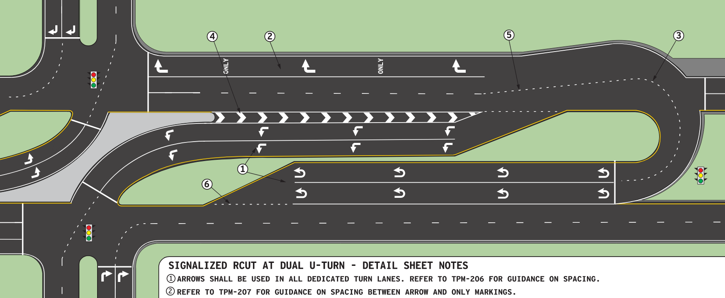
Signal-Controlled Pavement Markings
Dotted Line Extensions Required
U-turn Lane Stop Location and Traffic Signal Head
See TPM-205 & TPM-206 for turn arrow and chevron guidance.
Source: KYTC RCUT Design Guidance, Figure 34
Notes:
Figure 34 in the Guidance Document illustrates the pavement markings for a signalized RCUT with dual turning lanes.
Note the location of the STOP line perpendicular to the approach as opposed to parallel and closer to the opposing through traffic. This method was selected to maximize signal display visibility, to clarify the signal displays as U-Turn signal indications, and to minimize the need for supplemental signal displays.
Also note the required use of dotted line extensions to provide guidance for turning and U-turning traffic.

Slide 43
RCUT Traffic Signal Warrants
Follow procedures in the KYTC Traffic Operations Guidance Manual.
MUTCD does not have RCUT-specific warrants.
Warrants analysis replicates conflicting traffic movements at conventional intersection.
Cross-product evaluation of left-turn and/or U-turn vs. directional through traffic.
Use U-turn signal indications to control U-turning traffic movements.
Notes:
Traffic Signal requests for RCUTs follow the same procedures and coordination with Traffic Operations as other types of traffic signals on projects.
Since the MUTCD does not specifically address signal warrants analysis for RCUT movements, Traffic Operations has developed their own procedures for this engineering study.
The decision was made not to provide a “typical” signal layout since signal design is site dependent.
Early coordination is key to making sure the signal design is coordinated with the design features of the RCUT intersection. IT is also critical that adequate lead time is provided for the signal approval process and the signal design.
Manual on Uniform Traffic Control Devices, current edition (MUTCD): https://mutcd.fhwa.dot.gov/kno_11th_Editionr1.htm
KYTC Traffic Operations Guidance Manual, current edition: https://transportation.ky.gov/Organizational-Resources/Policy%20Manuals%20Library/Traffic%20Operations.pdf

Slide 44
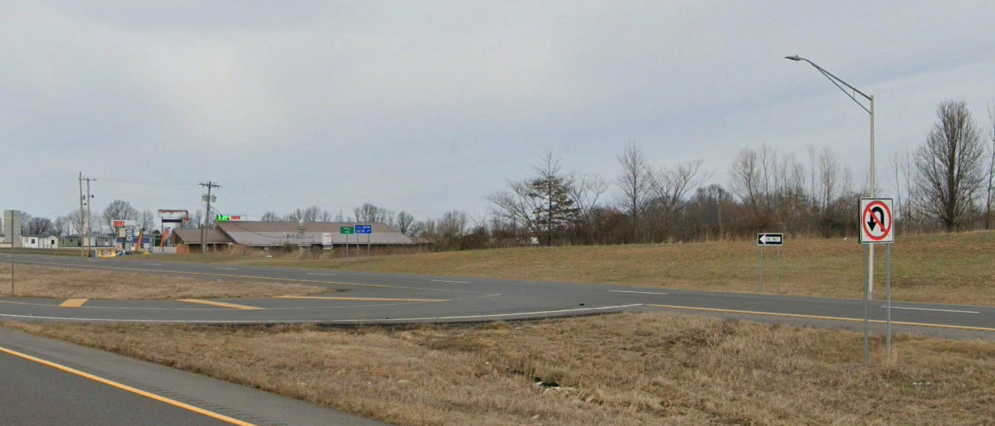
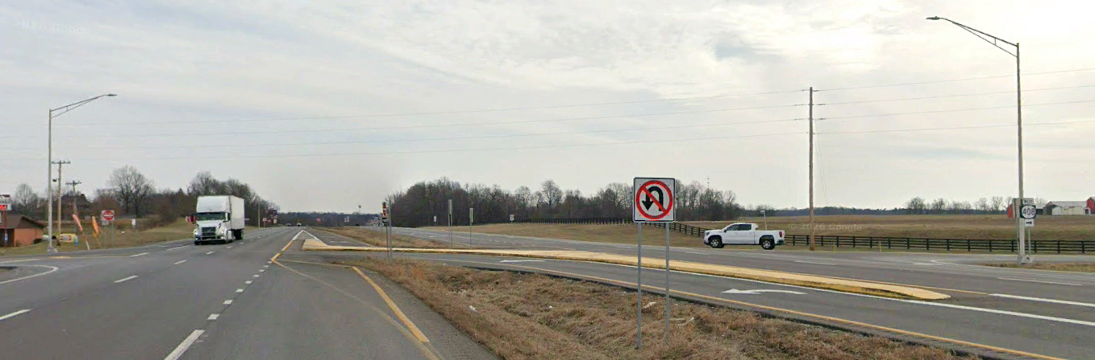
RCUT Lighting Warrants
Follow procedures in the KYTC Traffic Operations Guidance Manual Chapter 700.
When used, it is common to light only the main intersection and median U-turn openings.
US 45 at KY 408, Median U-turn Lighting
US 45 at KY 408, Main Intersection Lighting
Source: Google Streetview
Notes:
Unlike the roundabout lighting policy, the decision was made not to require intersection or roadway lighting at all RCUT intersections. A properly signed and marked RCUT intersection should operate sufficiently with lighting.
If a specific need for lighting is identified by a project team, or at an RCUT intersection after it is operational, follow the procedures for lighting requests and approval in the TOGM.
Note that the use of lighting may be specific to the main intersection or either of the two median U-turn openings, as opposed to lighting all three separate intersections or providing continuous roadway lighting.
Manual on Uniform Traffic Control Devices, current edition (MUTCD): https://mutcd.fhwa.dot.gov/kno_11th_Editionr1.htm
KYTC Traffic Operations Guidance Manual, current edition: https://transportation.ky.gov/Organizational-Resources/Policy%20Manuals%20Library/Traffic%20Operations.pdf

Slide 45
Operations and Maintenance
Maintenance is similar to other intersection types.
Raised channelization may need periodic street cleaning.
If cuts in raised channelization are provided for drainage, periodic debris removal by hand shovel may be needed.
During snow and ice events, all parts of an RCUT intersection need snow removal to function properly.

Slide 46
Questions?
Contact Information
Travis Thompson, PE
travis.thompson@uky.edu
Duane Thomas, PE
duane.thomas@uky.edu
KYTC RCUT Design Guidance

